Slide 1
Computer netWORKS GROUP
Variance Reduction
for reinforcement learninG
In Input-Driven Environments
aicon Project Group

Slide 2


Foundations
Variance Reduction for Reinforcement Learning
In input-driven environments

Slide 3
Foundations
Variance Reduction for Reinforcement Learning
In input-driven environments

Slide 4
Foundations
Variance Reduction for Reinforcement Learning
In input-driven environments

Slide 5
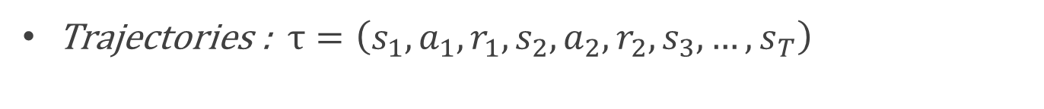
Foundations
Variance Reduction for Reinforcement Learning
In input-driven environments
MDP
Trajectories : $τ=\left(s_{1},a_{1},r_{1},s_{2},a_{2},r_{2},s_{3},…,s_{T}\right)$

Slide 6
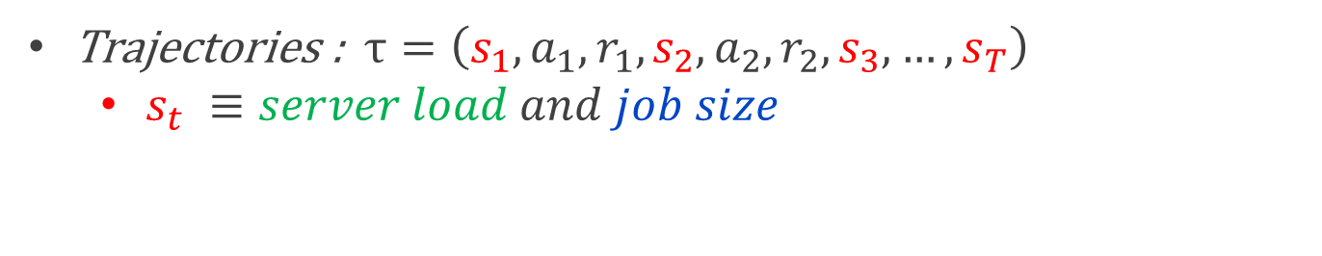
Foundations
Variance Reduction for Reinforcement Learning
In input-driven environments
3h
80%
40%
50%
MDP
Trajectories : $τ=\left(s_{1},a_{1},r_{1},s_{2},a_{2},r_{2},s_{3},…,s_{T}\right)$
  $s_{t} ≡server load and job size$

Slide 7
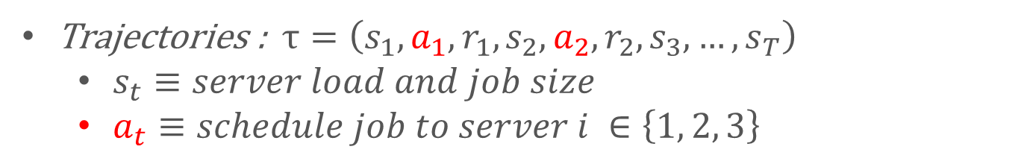
Foundations
Variance Reduction for Reinforcement Learning
In input-driven environments
MDP
Trajectories : $τ=\left(s_{1},a_{1},r_{1},s_{2},a_{2},r_{2},s_{3},…,s_{T}\right)$
  $s_{t}≡server load and job size$
  $a_{t}≡schedule job to server i ∈\left\{1, 2, 3\right\}$

Slide 8
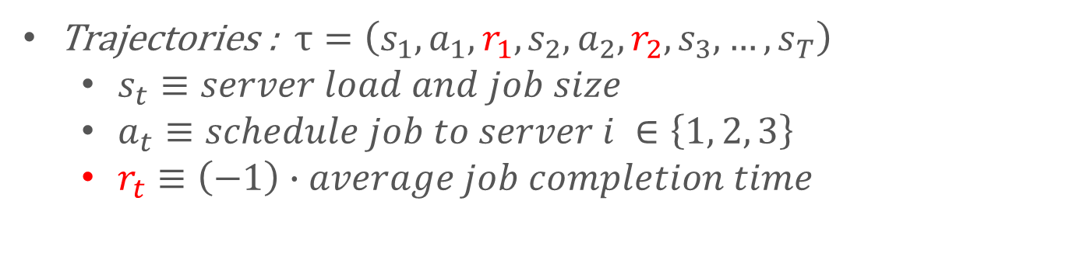
Foundations
Variance Reduction for Reinforcement Learning
In input-driven environments
MDP
Trajectories : $τ=\left(s_{1},a_{1},r_{1},s_{2},a_{2},r_{2},s_{3},…,s_{T}\right)$
  $s_{t}≡server load and job size$
  $a_{t}≡schedule job to server i ∈\left\{1, 2, 3\right\}$
  $r_{t}≡\left(−1\right)∙average job completion time$

Slide 9

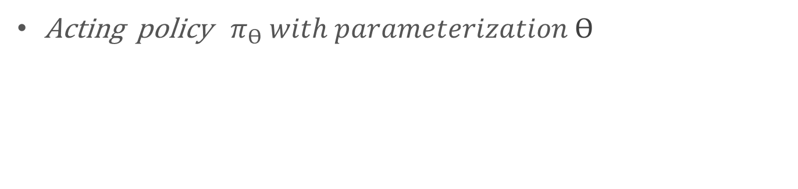


Policy Gradient Methods
Variance Reduction for Reinforcement Learning
In input-driven environments
Acting policy ${ π}_{ϴ} with parameterization ϴ$
$${ π}_{ϴ}(a_{t}|s_{t})$$
$$s_{t}$$
$$policy network$$

Slide 10
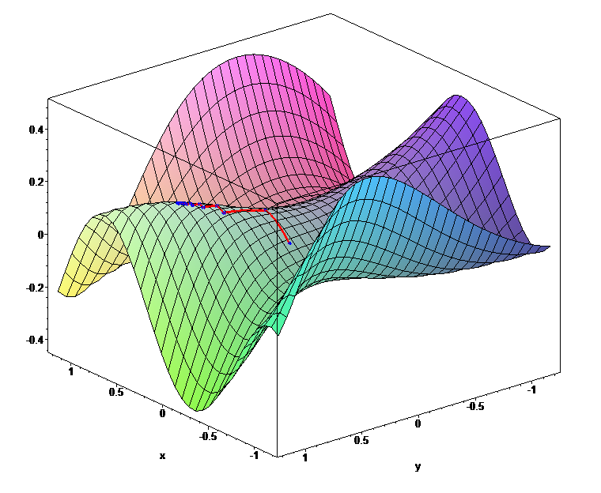
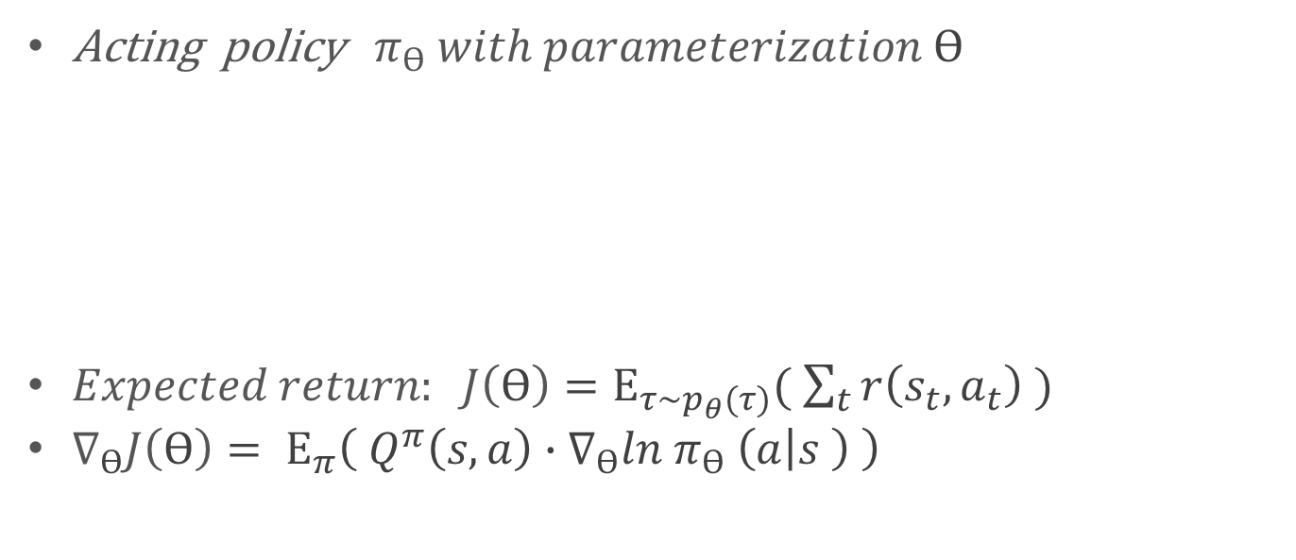


Policy Gradient Methods
Variance Reduction for Reinforcement Learning
In input-driven environments
Acting policy ${ π}_{ϴ} with parameterization ϴ$
$Expected return: J\left(ϴ\right)=Ε_{τ\sim p_{θ}(τ)}( \sum_{t}{r\left(s_{t}, a_{t}\right)} )$
$∇_{ϴ}J\left(ϴ\right)= Ε_{π}\left( Q^{π}\left(s,a\right)∙∇_{ϴ}ln π_{ϴ} \left(a | s \right) \right)$
$${ π}_{ϴ}(a_{t}|s_{t})$$
$$s_{t}$$
$$policy network$$
Source: [2]

Slide 11



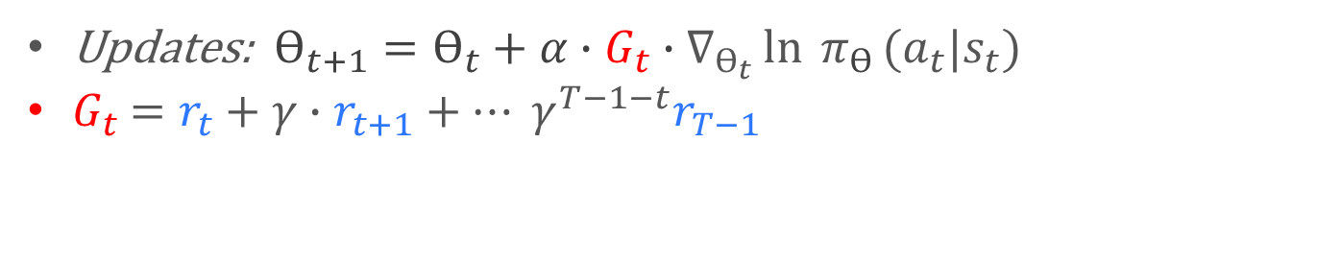






Variance Reduction for Reinforcement Learning
In input-driven environments
REINFORCE
Updates: $ϴ_{t+1}=ϴ_{t}+α∙G_{t}∙∇_{ϴ_{t}}\ln{{ π}_{ϴ}}(a_{t}|s_{t})$
$G_{t}$ $=r_{t}+γ∙r_{t+1}+… γ^{T−1−t}r_{T−1}$
$$r_{t}$$
$$r_{t+1}$$
…
$$r_{T−1}$$
$$s_{t}$$
$$a_{t}$$
$$s_{t+1}$$
$$a_{t+1}$$
$$s_{t+2}$$
$$s_{T}$$

Slide 12
Variance Reduction for Reinforcement Learning
In input-driven environments
REINFORCE
Updates: $ϴ_{t+1}=ϴ_{t}+α∙G_{t}∙∇_{ϴ_{t}}\ln{{ π}_{ϴ}}(a_{t}|s_{t})$
$G_{t}$ $=r_{t}+γ∙r_{t+1}+… γ^{T−1−t}r_{T−1}$
$$r_{t}$$
$$r_{t+1}$$
…
$$r_{T−1}$$
$$s_{t}$$
$$a_{t}$$
$$s_{t+1}$$
$$a_{t+1}$$
$$s_{t+2}$$
$$s_{T}$$
REINFORCE with Baseline
$ϴ_{t+1}=ϴ_{t}+α∙(G_{t} −{\hat{V}}^{π}(s_{t}))∙∇_{ϴ_{t}}\ln{{ π}_{ϴ}}\left(a_{t} | s_{t}\right)$

Slide 13
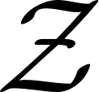



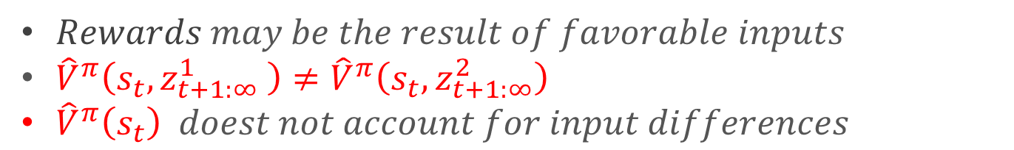

Input-Driven Environments
Variance Reduction for Reinforcement Learning
In input-driven environments
$$Input process$$
$$Input sequences$$
$$z^{1}$$
$$z^{2}$$
$Rewards may be the result of favorable inputs$
${\hat{V}}^{π}\left(s_{t}, z_{t+1:∞}^{1} \right)≠{\hat{V}}^{π}\left(s_{t}, z_{t+1:∞}^{2}\right)$
${\hat{V}}^{π}\left(s_{t}\right) doest not account for input differences$

Slide 14






Multi-Value Network Baselines
Variance Reduction for Reinforcement Learning
In input-driven environments
$${\hat{V}}^{π}(s_{t},z_{t+1:∞}^{1})$$
$$value network z^{1}$$
$$z^{1}$$
$$z^{2}$$
$$value network z^{2}$$
$${\hat{V}}^{π}(s_{t},z_{t+1:∞}^{2})$$

Slide 15
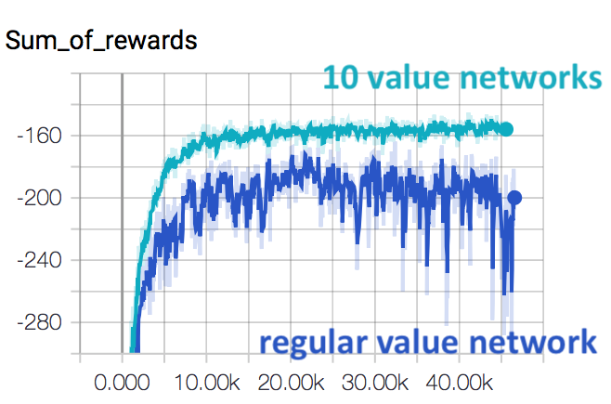
Experimental Results
Variance Reduction for Reinforcement Learning
In input-driven environments
Source: [3]

Slide 16
References
Variance Reduction for Reinforcement Learning
In input-driven environments
[1] H. Mao, S. B. Venkatakrishnan, M.Schwarzkopf, and M. Alizadeh. “Vari-ance reduction for reinforcement learningin input-driven environments”. In:arXivpreprint arXiv:1807.02264 (2018).
[2] Image source: https://upload.wikimedia.org/wikipedia/commons/6/68/Gradient_ascent_%28surface%29.png
[3] Image source: https://github.com/hongzimao/input_driven_rl_example/blob/master/figures/training.png

